Slide 1
2024 Grants NYC Public Schools
Looking at Proficiency % and the effects of English Language Learner Population size

Slide 2
The criteria
Goal
Goal continued
Data
A foundation is interested in identifying whether or not schools with large populations of English Language Learners show significantly more or less growth over time in
English Language Assessment (ELA) proficiency rates than schools with fewer English Language Learners.
Using NYC Public Schools information at
School ELA Results 2013-2023
Demographic Snapshot 2018-19 to 2022-23

Slide 3
Details of criteria
* Have 2019 3rd grade ELA proficiency rates as measured by state tests that are equal to or lower than 10 percentage points below the city average ELA proficiency rate in 2019 (ELA proficiency is defined as scoring a level 3 or 4 on the exam)
* Have at least 80% of their students categorized as living in poverty
* Be located in the borough of Brooklyn
* Not be part of a special district (District 75 or 79)

Slide 4
Assumptions
The average English Language Learners population / Non English Language Learners ratio for school year 2018-2019 is ~.137 We will take larger than a ratio of .15 as the starting point for large population but this can be a variable.

Slide 5
Challenges deep-dive
Challenge 1
Challenge 2
Challenge 3
Assumptions
We had to make some initial assumptions, but we would check all assumptions with the stakeholders.
Breakpoint
We calculated a ratio of .15 as the starting point for large population but this can be a variable.
Feedback
We will need feedback to continue with the analysis.

Slide 6
Solution
Live link to schools
And the Information Sheet
Results show that both Small ELL and Large ELL populations are increasing in proficiency

Slide 7
Implementation

Slide 8
We used the raw information to extract the salient data points and created a pivot table that filtered for the criteria and summarized.

Slide 9
This could be done via a database or application but the sheet method is good for reports and helps to make the information usable by all.

Slide 10
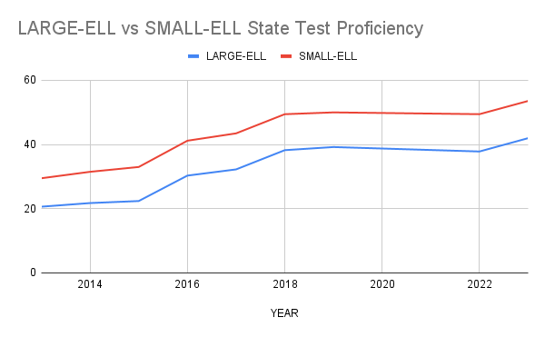

Slide 11
Results show that both Small ELL and Large ELL populations are increasing in proficiency

Slide 12
The team
Researcher
Ralph Yozzo
Ronny Reader
Abby Author
Perry Presenter
Vinny Viewer
Molly Maker
Casey Creator
Berry Books

Slide 13
Impact
max growth
Better Schools for All.

